Slide 1
Race ,Place, Politics, and Needles
Social Determinants Which Impact DTaP Vaccination Coverage in the United States
Imani-Michelle White * April 15,2016 * Spelman College *Research Day

Slide 2
Vaccinations
Diseases
Polio, measles, diphtheria, pertussis , tetanus, small pox in the 17th and 18th centuries
Child’s Wellbeing
Protection from life threating illness
Public Safety
Spreading of the disease to the general public including animals

Slide 3
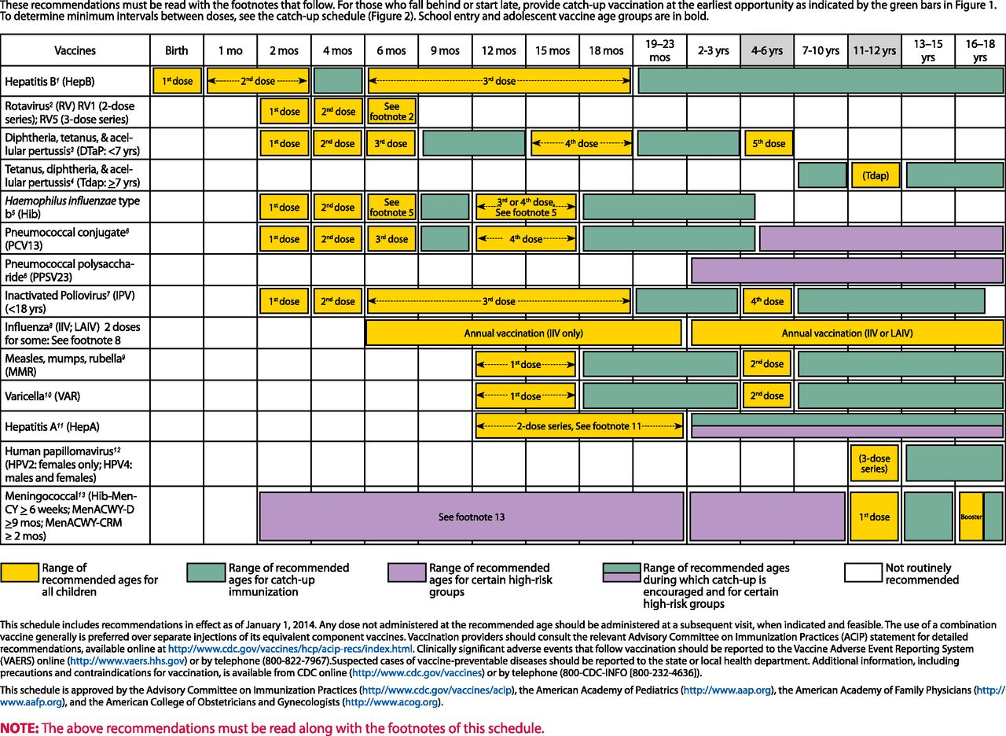
Vaccination Schedule
* Advisory Committee for Immunization Practices, CDC

Slide 4
Diphtheria
Tetanus
Acellular Pertussis
Contagious Bacterial Infection
Inflammation of Mucosal membranes
Throat = Hinder breathing and swallowing
Blood = Heart and nerve damage
Almost non existent
Bacteria Clostridium tetani
Nerve function
Muscle spasms in the abdomen, neck, stomach, and extremities
can be localized or generalized
called lockjaw since the muscle spasms in the face and neck can lead to the inability to open the mouth
Bacterial infection
Develops in infants
Breathing complications
Coughing spasms feeding difficulties
Pneumonia, encephalopathy, seizures, and death

Slide 5
Why This Study?
Social determinants of health may be related to these differences in vaccination coverage among children in the United States.
Objective
The purpose of this study was to evaluate various factors that contribute to the lack of Diphtheria, Tetanus, and acellular Pertussis (DTaP) vaccination coverage.
DTaP
Vital in preventing complications associated with acquiring each disease.
Coverage differs among sub- populations in the United States
Health disparities for various demographic subgroups

Slide 6
Methods
National Immunization Survey
The NIS is a population-based annual survey used to obtain national, state, and local area estimates of vaccination coverage among children aged 19 to 35 months.
1
Telephone interviews
50 states, D.C., six local areas
2
Random digit dialing = landline and cell phones
N=24,897
3
Flu Vaccinations, Demographics, and Healthcare type/insurance
4
Immunization History Questionnaire
5
Weighted amount for non-response
6
Used univariate and bivariate parameters
Analyzed suing SAS callable SUDAAN software

Slide 7
Analysis of Variables
Race/Ethnicity
Child’s Age
Receiving W.I.C.
Benefits
U.S. Region
County Area
Provider Facility Type
Mother’s Age
Sex
Mother’s Education
Mother’s Marital Status

Slide 8
Results

Slide 9
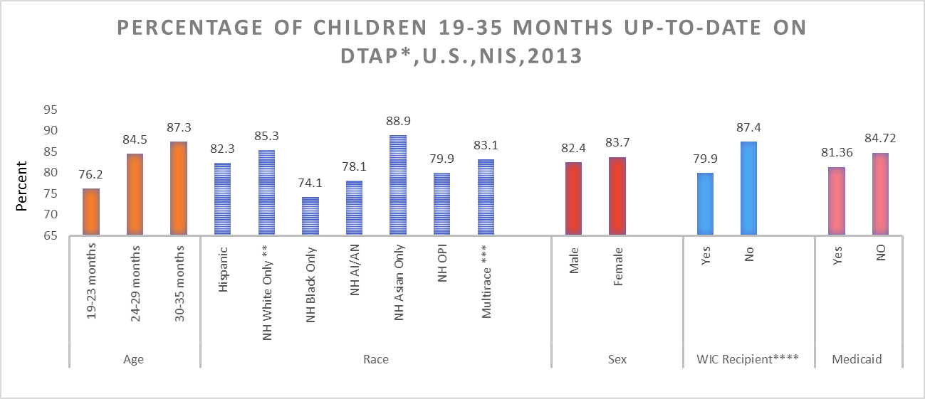

Slide 10
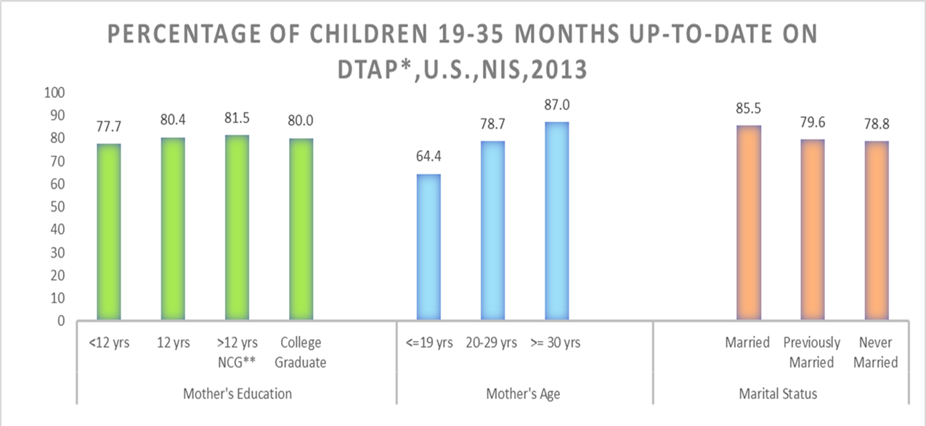

Slide 11
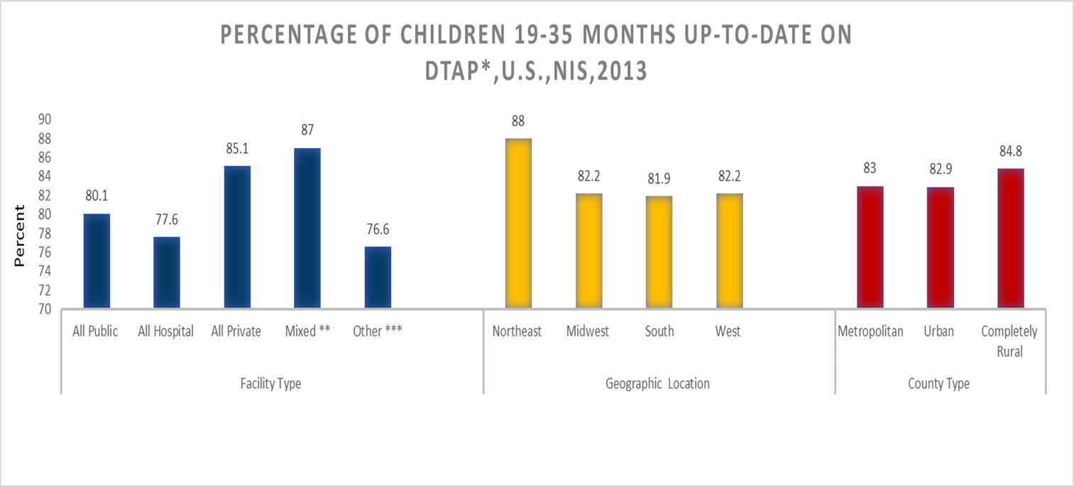

Slide 12
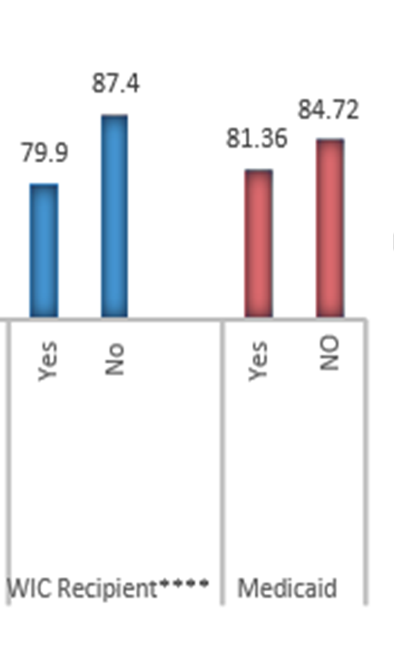
Race/Ethnicity
Receiving W.I.C.
Benefits
Poverty Status
Provider Facility Type
Mother’s Age
Mother’s Education
DTaP Up-to- date Status
Race/Ethnicity
DTaP Up-to- date Status
Why the similarities ?

Slide 13
Bioinformatics
Uploaded 2014 NIS Data (CDC)
R Studio
R Studio HMISC library
Bar Graph of DTaP Vaccinations and Up-to-date status
Regression between variables of interest
Calculated p-value and R-squared values
Mean Number of DTaP Vaccination by 36 months

Slide 14
Variable | Categories | Number of levels
Number of vaccinations by 36 months | 1,2,3,4,5,6 | 6
Poverty Status | ABOVE POVERTY, > $75K ABOVE POVERTY, <= $75K BELOW POVERTY | 3
Is Child Currently Receiving WIC | Yes, No | 2
Mother’s Age | >19 years, 20-29 years, 30 years < | 3
Vaccination provider receives Vaccines for Children | Yes, No | 2
Child’s Race | White only. Black Only, Other race | 3
Number of vaccination providers | 0,1,2,3 < | 4
Is child covered by Medicaid or S-chip | Yes, No | 2
Is Child Up-to-Date | Yes, No | 2

Slide 15
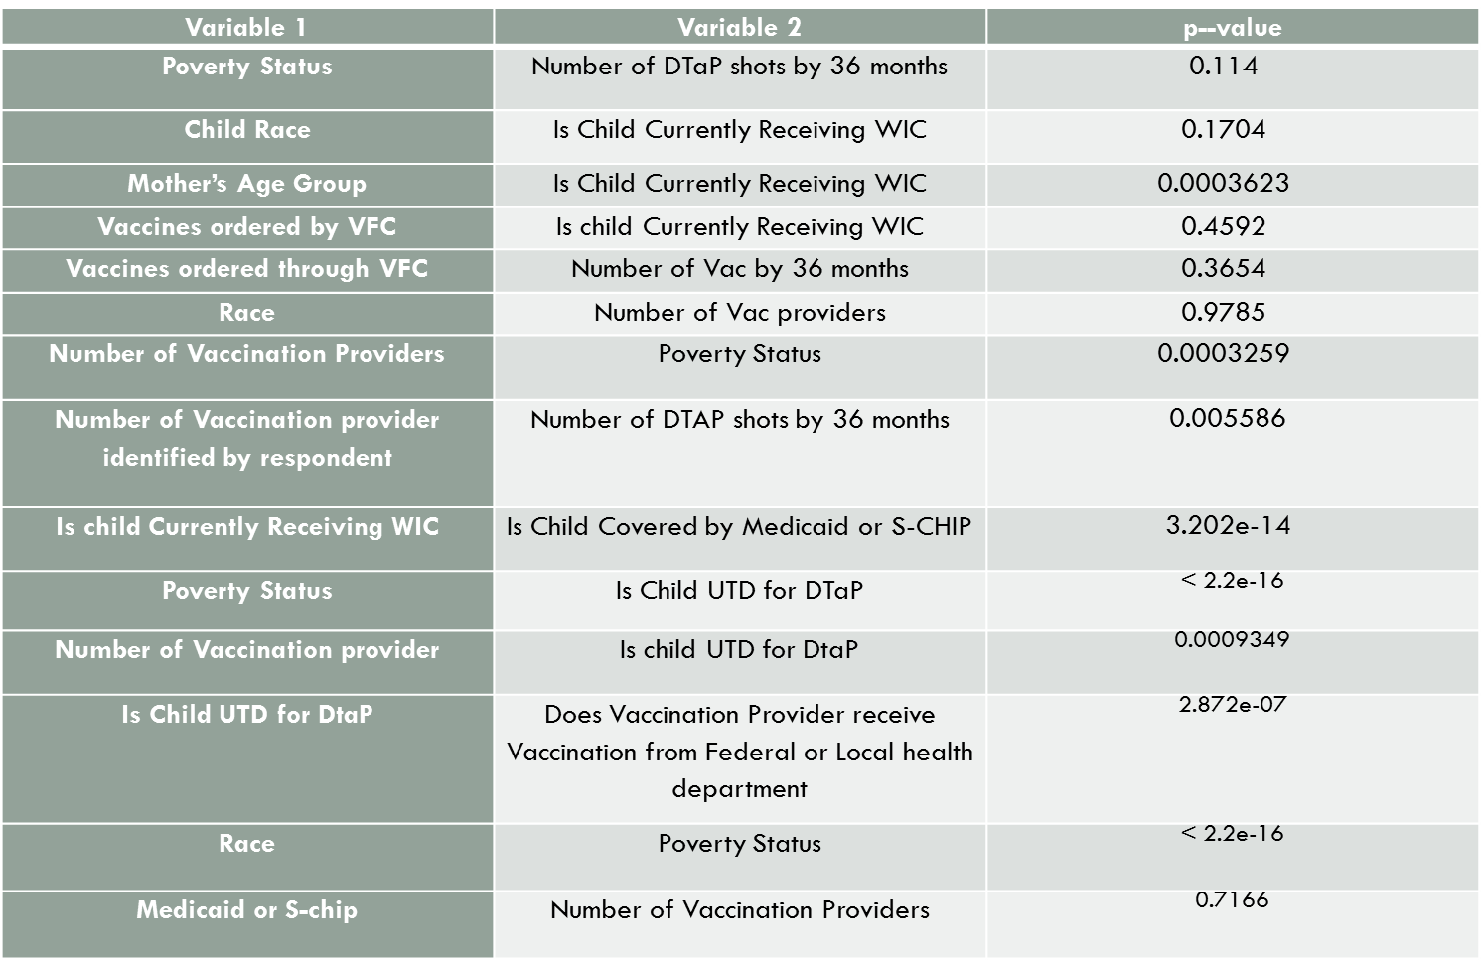
Notes:
The first statistically significant regression between Mother’s Age Group and child’s WIC status yielded a p-value of 0.0003623. The smaller the p-value the more evidence we have against the null hypothesis. This means that we can reject H0 (No affect) suggesting that a child’s WIC recipient status is affected by the mother’s age. The same type of relation resulted between Number of Vaccination Providers and Poverty Status ( p-value = 0.0003259), the Number of Vaccination Providers and the Number of DTAP-only shots by 36 months (p-value =0.005586), Number of Vaccination providers and child’s up-to-date status for DTaP (p-value =0.0009349).
An even stronger relationship is illustrated between Child’s WIC status and Child’s Medicaid or S-CHIP status (p-value = 3.202e-14), Poverty Status and Child’s DTaP up-to-date status (p-value = < 2.2e-16), Child DTaP up-to-date status and if the Vaccination Provider receives Vaccinations from Vaccines for Children (VFC) (p-value = 2.872e-07), and finally child’s Race and Poverty Status (p-value = < 2.2e-16).
The first statistically significant regression between Mother’s Age Group and child’s WIC status yielded a p-value of 0.0003623. The smaller the p-value the more evidence we have against the null hypothesis. This means that we can reject H0 (No affect) suggesting that a child’s WIC recipient status is affected by the mother’s age. The same type of relation resulted between Number of Vaccination Providers and Poverty Status ( p-value = 0.0003259), the Number of Vaccination Providers and the Number of DTAP-only shots by 36 months (p-value =0.005586), Number of Vaccination providers and child’s up-to-date status for DTaP (p-value =0.0009349).
An even stronger relationship is illustrated between Child’s WIC status and Child’s Medicaid or S-CHIP status (p-value = 3.202e-14), Poverty Status and Child’s DTaP up-to-date status (p-value = < 2.2e-16), Child DTaP up-to-date status and if the Vaccination Provider receives Vaccinations from Vaccines for Children (VFC) (p-value = 2.872e-07), and finally child’s Race and Poverty Status (p-value = < 2.2e-16).

Slide 16
Implications of the Study
Not every person in the United States has a phone = unable to participate in the National Immunization Survey.
Only about 33% of cell phone users responded and 60% e landline responses.
However, IHQ can only be given to providers if the respondent of the survey gives consent.

Slide 17
Conclusion and Suggestions
R Studio analysis provided strong evidence that social determinates affect a child’s ability to be fully immunized for DTaP in the United States
State and local health departments must establish a system to overcome the differences among these unimmunized children
Creating outreach programs that are culturally (race and religion)
Vaccines For Children (VFC) should be distributed to mother’s whose children are currently receiving WIC and Medicaid/S-CHIP coverage.
Allow children opportunity to receive vaccinations at school
Healthy People 20/20 standards social determinates of health need to produce smaller correlations with access to health care
Notes:
Health disparities still exist among various sub- group
Literature on vaccination providers who receive vaccines from the Vaccines For Children (VFC) should be distributed to mother’s whose children are currently receiving WIC and Medicaid/S-CHIP coverage.

Slide 18
Acknowledgements
Project: IMHOTEP – Morehouse College
Dr. Laurie Elam –Evans, Lead Health Scientist ,NCRID CDC
Dr. Holly Hill, Medical Officer NCRID CDC
Dr. Hong Qin – Spelman College

Slide 19
References
CDC. (2014, May 15). Diphtheria . Retrieved from Centers For Disease Control : CDC 24/7 Saving Lives,Protecting
People : http://www.cdc.gov/diphtheria/clinicians.html
CDC. (2015, February 13). National Immunization Survey . Retrieved from Centers for Disease Control and
Prevention : http://www.cdc.gov/vaccines/imz-managers/nis/about.html
Centers for Disease Control and Prevention . (2013, February ). Understanding how vaccienes Work . Retrieved from Centers for Disease Control and Prevention: http://www.cdc.gov/vaccines/hcp/patient- ed/conversations/downloads/vacsafe-understand-color-office.pdf
HealthyPeople.gov . (2015, June 16). Social Determinates of Health . Retrieved from Healthy People.gov Healthy
People 2020: http://www.healthypeople.gov/2020/topics-objectives/topic/social-determinants-health
Medicine.Net . (2012, March 19). Definition of Diphtheria . Retrieved from Medicine.Net : We Bring Doctors
Knowledge to You : http://www.medicinenet.com/script/main/art.asp?articlekey=3005
Sirkus, L. (2010). NCHS Data on Pertussis Hospitalizations in Young Children. Atlanta : Centers For Disease
Control and Prevention .
Stoppler, M. (2014, December 1). Do You Need a Tetanus Shot? Retrieved from Medicine.Net :
http://www.medicinenet.com/script/main/art.asp?articlekey=47225
The College of Physicians of Philidelphia . (2015, March 16). History of Vaccienes Timelines. Retrieved from
History of Vaccienes: http://www.historyofvaccines.org/content/timelines/all
Tiwari, T. S. (2014). Chapter 16: Tetanus Manual for the Surveillance of Vaccine-Preventable Diseases. Atlanta : Centers For Disease Control and Prevention .

Slide 20
U.S . National Library of Medicine . (2013, July 30). Smallpox: a Great and Terrible Scrouge . Retrieved from NIH: U.S. National Library of Medicine : http://www.nlm.nih.gov/exhibition/smallpox/sp_vaccination.html
U.S. Department of Health and Human Services . (2015). Health,United States 2014. Atlanta : Centers For
Disease Control and Prevention .
World Health Organization . (2014, December 3). Immunization, Vaccines and Biologicals Diphtheria . Retrieved from World Health Organization :
http://www.who.int/immunization/monitoring_surveillance/burden/diphtheria/en/

Slide 21
Thank You !

